Slide 1
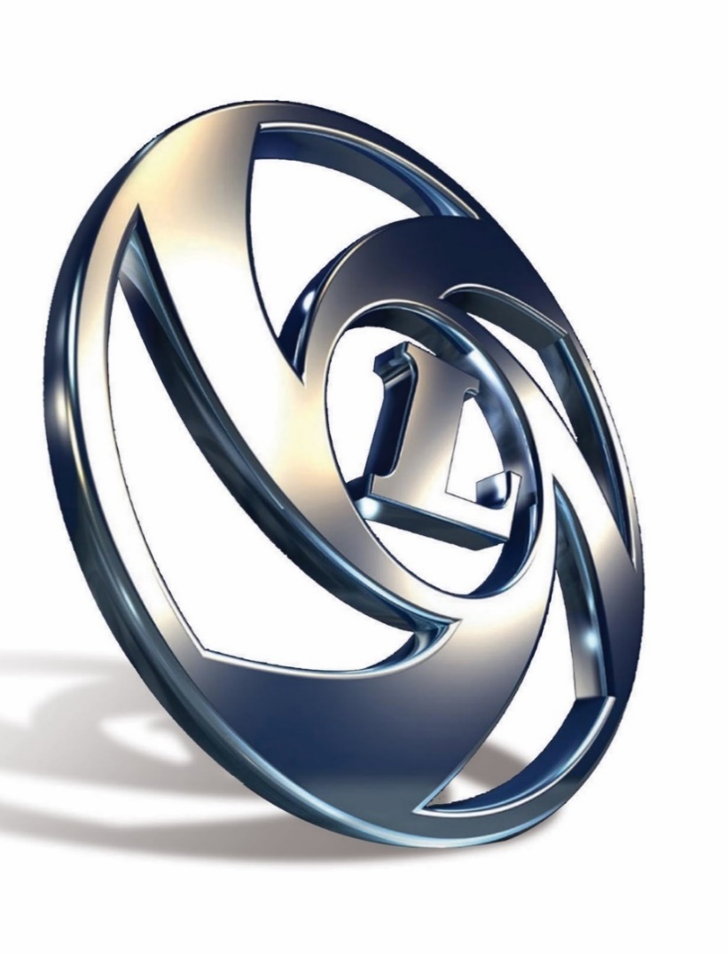
HMV/LMV - Fresh Driver Training
Rule No. 31 of The Central Motor Vehicle Rules 1989

Slide 2
Syllabus for Fresh Driver Training
DRIVING THEORY – I
TRAFFIC EDUCATION – I
LIGHT VEHICLES DRIVING PRACTICE
VEHICLE MECHANISM AND REPAIRS
MEDIUM AND HEAVY VEHICLE DRIVING THEORY –II
TRAFFIC EDUCATION –II
PUBLIC RELATIONS FOR DRIVERS
HEAVY VEHICLE DRIVING PRACTICE
FIRE HAZARDS
VEHICLE MAINTENANCE
FIRST AID
NOTE: SECTION WISE SYLLABUS BREAK – UP:
HMV/HTV - Transport vehicles - Parts. D,E,F,G,H,I,J and K
LMV - Non-transport vehicles - Parts A,B,C,D,F,G and K
Notes:
Trainer Notes:- 1) Brief about the course duration and guidelines to trainees
2) Topics to be covered separately for HMV/LMV training
3) Difference in Driving Theory-I & II and Traffic Education-I & II topics

Slide 3
SECTION-A :
DRIVING THEORY-I
Notes:
Trainer Notes : 1) For LMV Course

Slide 4
TOPICS
Know Your Vehicle
Vehicle Controls
Pre-Driving Checks
Beginning to Drive
Driving on the Road
Driving at intersections
Manoeuvres
Reversing
Parking
Driver’s Responsibility on the Road
Priority for Certain Vehicles
Notes:
Trainer Notes :1) Brief about each of the topics

Slide 5
1.Know Your Vehicle
Simple introduction to automobile engines and their working and Parts
Notes:
Trainer Notes :- 1) Basics of an automobile engines ( 2Stroke/4Stroke) and main engine components.

Slide 6
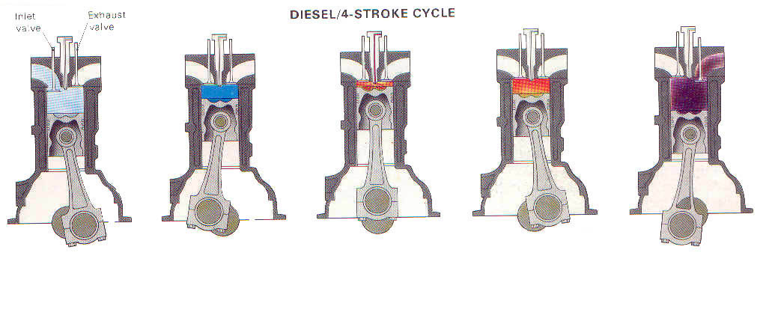
Four Strokes
Suction Stroke
In this stroke, piston travels from TDC ( Top Dead Center ) to BDC ( Bottom Dead Centre ) and Inlet valve opens due to which the air is taken inside the cylinder.
Compression Stroke
In this stroke air is compressed as the piston travels from BDC to TDC. Both Inlet & exhaust Valves remain closed during this stroke. Due to compression, the temp of the air increases.
Injection/ Power Stroke
Fuel is injected at high pressure in this stroke on the hot compressed air inside the cylinder due to which the fuel gets burned and results in developing of power. Piston again travels from BDC to TDC. Both valves remain closed.
Exhaust Stroke In this stroke, piston again travels from BDC to TDC and the exhaust valve opens thereby allowing the burnt exhaust gases to leave from cylinder.
Notes:
Trainer Notes: 1) Explain the basic energy conversion phases in the engine ( Chemical to Thermal To Mechanical).
2) Explain the working of an engine / different strokes, different terms ( TDC, BDC etc.).
Questions :- 1)What is the piston movement in suction stroke ??
BDC to TDC (b) TDC to BDC
(2) What is the Valve Opening position in exhaust stroke ?
(a) Inlet open, Exhaust Closed (b) Inlet Closed, exhaust open (c ) Both Open (d) Both Closed

Slide 7
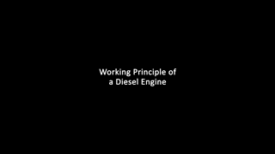
Working of Engine
ENGINE WORKING VIDEO:

Slide 8
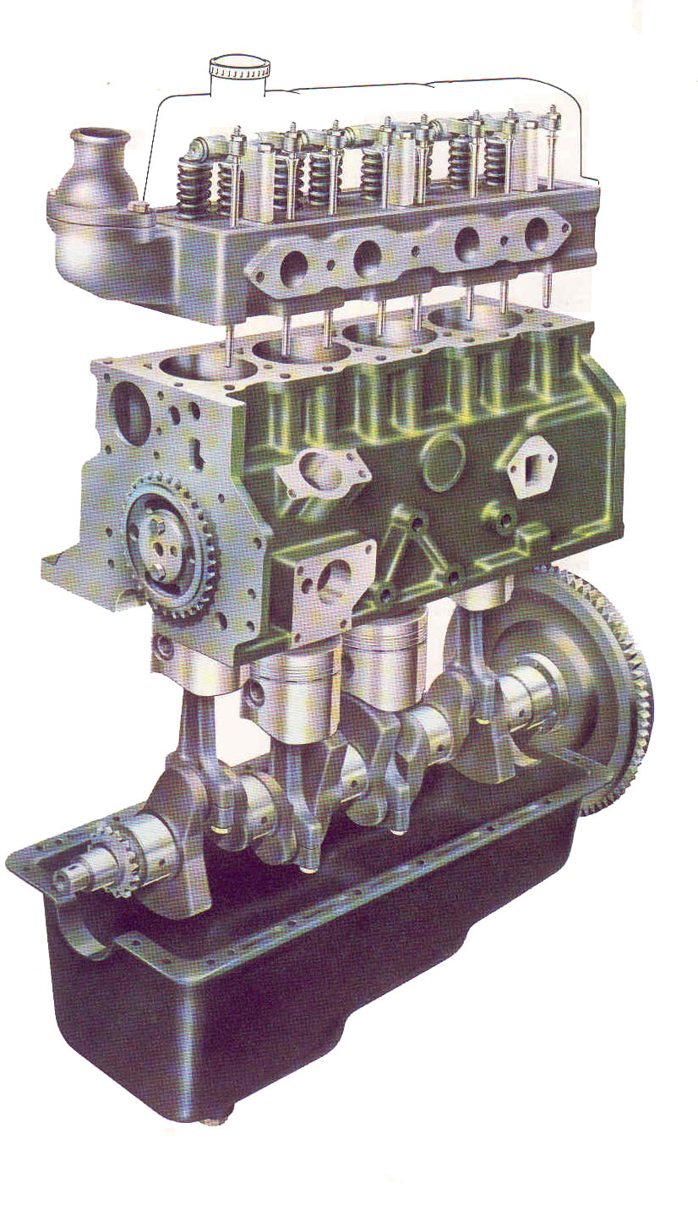
Main Parts - Engine
1 Cylinder Block
2 Cylinder Head
3 Crank shaft
4 Camshaft
5 Pistons
6 Connecting Rods
7 Flywheel
8 Timing Gears
9 Rocker Shaft Assembly
9
1
2
4
8
7
5
3
6
Notes:
Trainer Notes:- 1) Working of different parts in brief.
2) Identify / Name different parts.

Slide 9
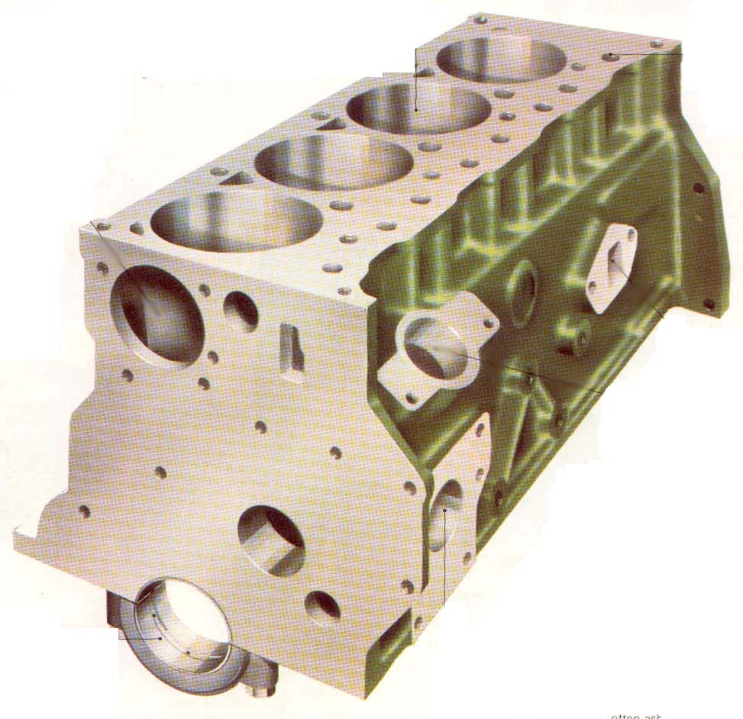
Cylinder Block
This is the main part of the engine
Camshaft, Crankshaft, Pistons etc. are the main parts fitted inside the Cylinder Block. Also FIP, Timing Gears, Oil Pump etc. are fitted on the block itself.
There is water jacket provided to cool down the cylinder block with the help of a coolant.
Oil galleries are also provided to lubricate different parts inside the block.
Notes:
Trainer Notes:- 1) Explain the purpose of the cylinder block.
Questions – How many cylinders are there in this block shown here? ( 4 or 6 cylinder)

Slide 10
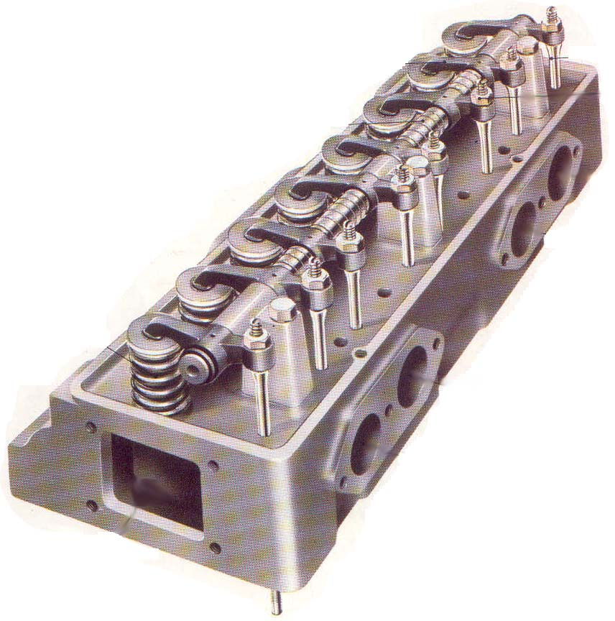
Cylinder Head
Inlet & Exhaust Valves, Rocker Shaft and Tappets etc. are fitted in the Cylinder Head
There is water jacket to cool down the cylinder head. Also there are oil galleries provided for lubrication purposes.
Notes:
Trainer Notes :- 1) Major components fitted in cylinder head and their working
2) How many valves are there in this cylinder head shown ( 4, 6, 8 or 12 valves)

Slide 11
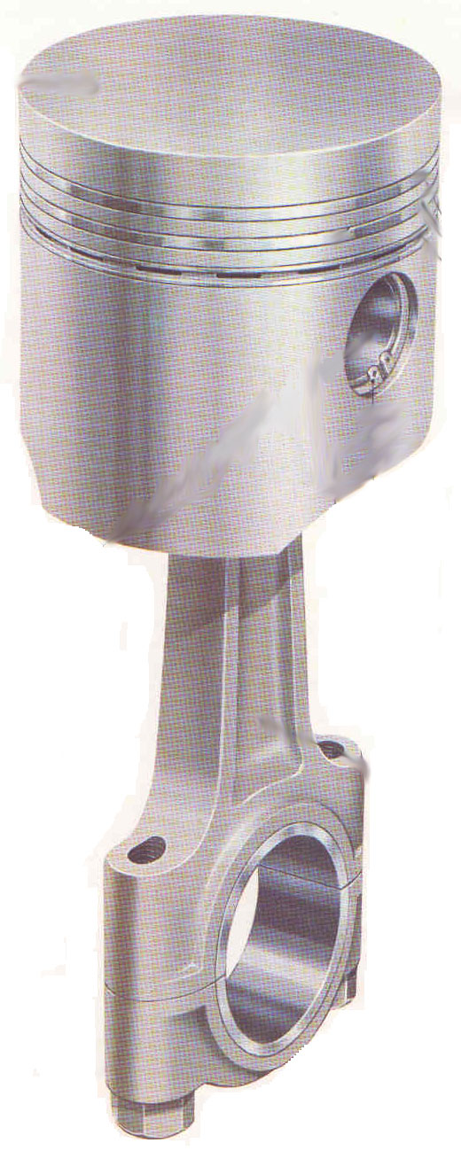
Piston and Connecting Rods
Piston is used to compress the intake air inside the compression chamber. It has three rings ( 2 compression rings and 1 oil ring )
Connecting Rods are used to transfer the power from piston to crankshaft.
Notes:
Trainer Notes:- 1) Explain about the movement of the piston
2) Explain Power flow from Piston to Gudgeon Pin to Connecting rod to Crankshaft.
3) What is the material of the piston ?( Cast Iron or Aluminum Alloy or Aluminum )
4) What are various components of the piston assembly ? ( Piston, Piston Rings, Gudgeon Pin, Circlips)
5) What are the two ends of the connecting rod called as?? ( Big end & Small end)

Slide 12
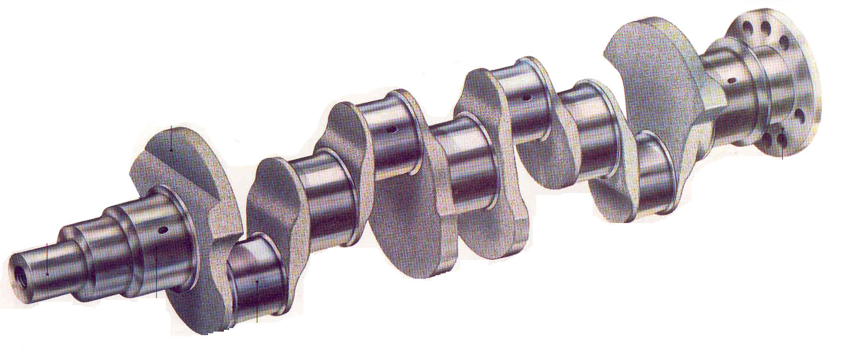
Crankshaft
Connecting rods are fitted on the crankshaft
Crankshaft transfers the power generated by the engine to the gear box
Main Parts of the Crankshaft are:-
Journals
Crankpin
Web
Notes:
Trainer Notes :- 1) Explain the function of journals ( big end bearing)
2) How many crank pins are there in this picture? (4,5,6,9)

Slide 13
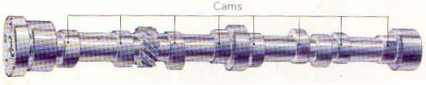
Camshaft
Cam shaft opens and closes the Inlet & Exhaust valves during the four stroke operation of the engine.
Main Parts of the cam shaft are:-
Journals
Cam lobes
Notes:
Trainer Notes:-1) Explain the function of camshaft.
2) How many cam lobes are there in this picture ? ( 4,6,8,12)

Slide 14
2. Vehicle Controls:
Foot controls
Hand controls
Other controls
Notes:
Trainer Notes:- 1) What is the need of having controls in the vehicle ?

Slide 15
Vehicle Controls
CONTROLS:
Drivers should have correct understanding and correct use of controls in the vehicles.
Controls are broadly divide into:
Major Controls
Minor Controls
Notes:
Trainer Notes :-1) Explain the Classification of controls based on the criticality of the vehicle operation.

Slide 16
Vehicle Controls
Major Controls
Accelerator
Brake pedal
Clutch pedal
Steering wheel
Gear Lever
Hand Brake lever
Minor Controls
Rear View Mirror
Wind screen and Wiper System
Head light switch
Parking light switch
Reverse light switch
Direction Indicator switch
Starter switch
Horn
Instrument Panel.
Notes:
Trainer Notes:-1) Explain A,B,C,S,G,H concept for major controls and their locations in the vehicle.
2) Explain the hand-foot-eye coordination for major controls.
3) Explain different types of rear view mirrors ( Outer RVM, Inner RVM )
4) Explain the logic of using Major & Minor Controls judiciously.( If Minor controls are used, then Major controls need not be used unnecessary ).

Slide 17
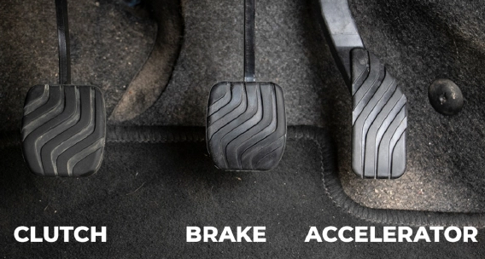
Vehicle Controls
MAJOR CONTROLS: ACCELERATOR:
Helps to increase or decrease engine speed.
Driver should use accelerator to steadily increase/ decrease speed
Sudden acceleration and sudden deceleration is not advisable.
Driver should identify the road conditions from time to time and suitably increase/ decrease the speed there by avoiding frequent and sudden braking so as to achieve lesser wear and tear of the vehicles and save fuel saving.
Notes:
Trainer Notes:- 1) Explain the purpose and proper use of Accelerator Pedal
2) Types of Accelerator Pedals ( Mechanical & Electronic Type)
3) How the Accelerator Pedal is controlled in the vehicle ?? ( By hand, By left foot, By right foot)

Slide 18
Vehicle Controls
Major Controls: Brake Pedal
Brake pedal is used to stop the vehicle. Just by pressing the brake pedal the vehicle gets slow down and stop.
Avoid sudden braking; Try to apply brake gradually.
By proper prediction, unnecessary braking can be avoided.
While climbing down a gradient, do not run the vehicle in neutral and apply brake.
Before entering a road- bend, reduce speed ahead of the bend; avoid applying brakes at the bends.
Don’t apply sudden brakes at the slippery roads;
At high speeds unless the wheels are in straight position, do not apply sudden brake.
After running the vehicle in a water-clogged road, deplete the water by repeatedly applying brake a few times, so that the brake drum and brake shoes get dried.
Notes:
Trainer Notes :- 1) Explain the purpose and proper use of the brake pedal.
2) How is the brake pedal pressed? ( by right foot, by hand, by left foot )

Slide 19
Vehicle Controls
Major Controls: Clutch Pedal
This is helping smooth engagement / disengagement of engine with gearbox while changing gears.
This helps the vehicle to be driven with out much of shocks and jerks.
In the vehicles fitted with constant mesh Gearbox, you have to double de-clutch, while driving.
In Synchro mesh Gearbox fitted vehicles only single de-clutching is enough.
To move the vehicle without much of jerking, and in the gradients not to allow the vehicle to roll back, driver should under stand the two important position of clutch pedal position:
Clutch Biting Point
Clutch Balance Point
Notes:
Trainer Notes :- 1) Explain the purpose and proper use of the Clutch pedal.
2) How is the clutch pedal pressed? ( by right foot, by hand, by left foot )

Slide 20
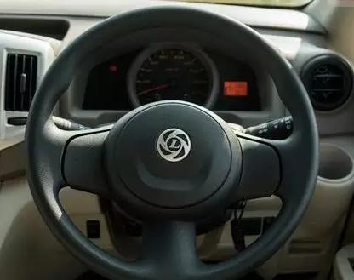
Vehicle Controls
STEERING WHEEL
The steering wheel is joined with the shaft of the steering box. While turning the wheel, through the linkage connections the wheels are turned.
The steering wheel should be turned smoothly and steadily.
Through the steering wheel, the driver can sense some defects in the vehicle and sometimes it is called as the stethoscope of the vehicle.
While turning the driver should not over steer or under steer the wheel.
Notes:
Trainer Notes:- 1) Explain the proper holding position of the steering wheel ( LMV & HMV).
2) Briefly talk about Manual and Power Steering types.
3) Steering Wheel controls which tyres ? ( Front, Rear or Both )

Slide 21
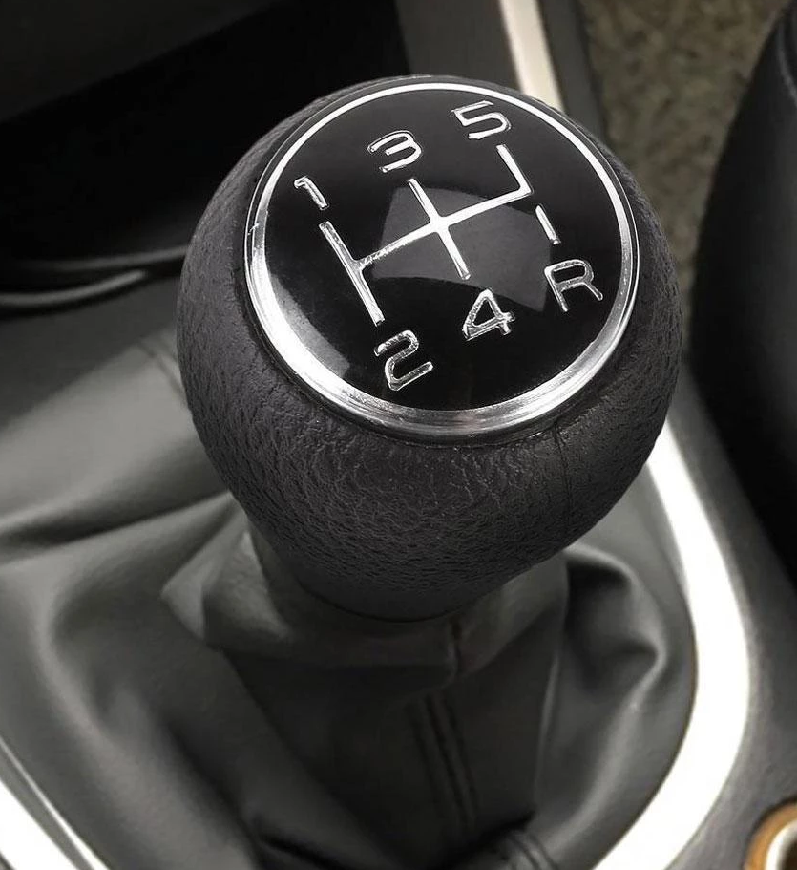
Vehicle Controls
Gear Shifter Lever
To adjust with the speed and torque, the Gear lever is used to select the right gear.
Do not slam the gear lever.
While changing gear, the clutch pedal should be fully pressed; otherwise it will lead to “ Gear Noise” and subsequent damage to gears.
For the vehicles fitted with synchro mesh gear box, the driver should follow :- “Pressure point shift” method, while changing of gears. Single de-clutching is sufficient for synchromesh gears.
Notes:
Trainer Notes:-1) Explain Different Types of Gear Boxes ( 4/5/6) and Gear Levers.
2) Which hand should be used to operate the gear lever ( Right / Left / Both )

Slide 22
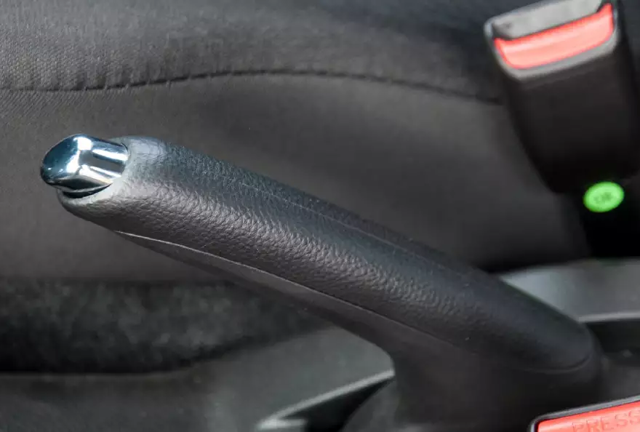
Vehicle Controls
Hand Brake Lever
Hand brake is used to park the vehicle, and preventing it to move.
While starting release the hand brake.
If normal service brake system fails, the driver can shift to lower gears and can gradually apply hand brake and bring the vehicle to a stop.
Always keep the hand brake in working condition.
Notes:
Trainer Notes :- 1) Explain the purpose and proper use of Hand Brake Lever.
2) When the parking brake is engaged, “P” symbol gets displayed in the instrument cluster.
3 ) Normally, parking brake acts on which wheels ? ( Front / Rear / Both ).

Slide 23
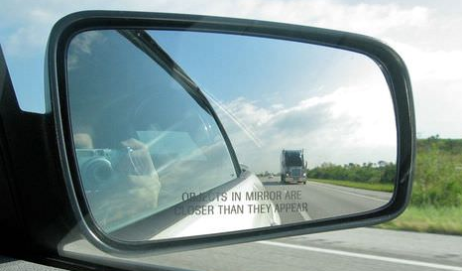
Vehicle Controls
Minor controls: Rear view mirror (RVM)
1.Flat mirror
2.Convex mirror
In the flat mirror the exact distance can be seen whereas in the convex mirror, the vehicle will appear as if it is farther away when compared with flat mirror, but the entire width of the road can be seen in convex mirror.
Driving a vehicle without RVMs shall attract penalty as per CMVR.
It is recommended that RVMs should be adjusted in such a way that it covers 80% of the road and 20% of the vehicle body.
For better visibility of the traffic behind the vehicle.
Notes:
Trainer Notes :- 1) Why Rear View Mirrors are required ? ( For better visibility of the traffic behind the vehicle and avoiding blind spots & CMVR compliance also-Section 5 &7 ).
2) Types of RVMs ( Outer RVM & Inner RVM) / No of RVMs used ( Left, Right & Inner ).
3) Explain Difference between Flat & Convex Mirrors

Slide 24
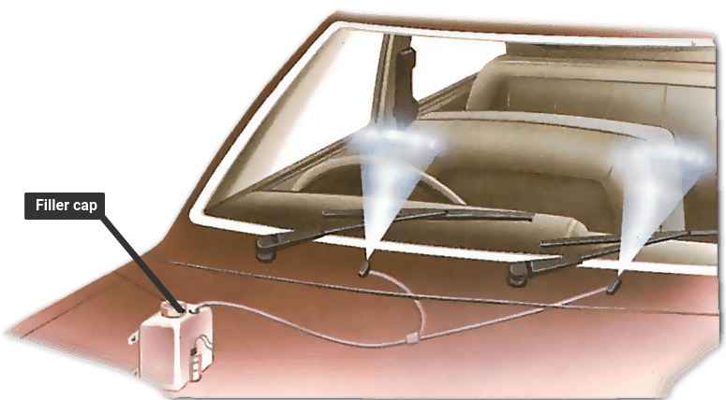
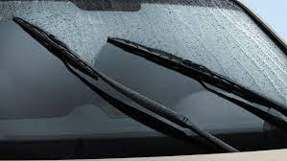
Vehicle Controls
Minor Controls: Wind Screen & Wiper System
Wind Screen :-
It is fitted in the front of the vehicle and provides visibility while protecting the occupants from the elements like wind, debris such as dust, insects etc.
It provides the aerodynamic shape to the vehicle to reduce the wind drag and improves vehicle performance.
Wiper System :-
It consists of a wiper motor and wiping arms & wiping blades.
The wiping blades are used to clean the wind screen glass to improve the visibility in adverse weather conditions.
Notes:
Trainer Notes:- 1) Explain the function of Intermittent , Low , Medium, High speed Function of Wiper Motor.
2) Explain the water spray nozzle of the wiper system.
2) Explain the material of Wind Screen ( Toughened Glass).

Slide 25
Vehicle Controls
Minor Controls: Wind Screen & Wiper System
Dos & Don’ts :
Do not rub the wind screen glass with a dry cloth; this will create scratches on it. Do not use rough / soiled cloths for cleaning.
Always clean the wind glass with water first and then with a clean cloth.
Do not use wiper when there is no rain otherwise it will form scratches on the glass and also wear & tear of wiper blade.
If there is drizzling, splash water on glass first and then use wiper; if it is raining allow a few seconds to clean the dust on the glass by rain water and then use the wiper.
Switch off the wiper immediately after rains.
If possible use the wiper motor intermittently during rains. If there is speed control in wiper motor speed , reduce the speed according to rains.
Do not use cloths with buttons / hooks to clean the wind screen , the glass will get scratches, which in turn will refract head light in night time and you will get a glared vision.
Notes:
Trainer Notes:- 1) Explain the precautions to be taken with respect to wind screen and wiper system.

Slide 26
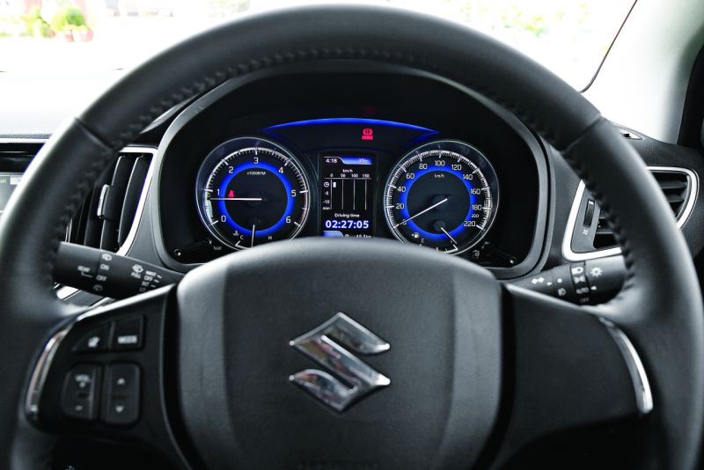
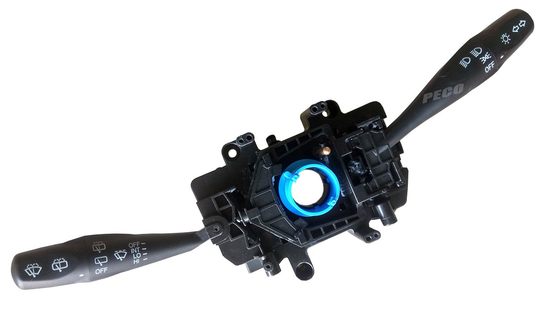
Vehicle Controls
Combination Switch:-
It basically has following switch systems integrated in it :-
Parking Switch
Head Light Switch
Hi / Lo Beam / Passing Switch
Wiper Switch ( Intermittent, Lo, Med, High speed)
Wind Screen Washer Switch
Indicator Switch ( Left / Right )
Notes:
Trainer Notes :- 1) Explain the controls on RH & LH side of the Combination Switch.

Slide 27
Minor Controls – contd.
Parking Lights & Switches
Parking Light is switched “ON” by rotating Switch KNOB to first setting.
If you happen to park the vehicle on roadsides in night times or in case of Low visibility, always use-parking lights.
Parking lights should be in amber colour in the front and red colour in the rear.
Parking lights should never be in red colour in the front.
Use reflective stickers white in the front and red in the rear, this will help in avoiding accidents in night time and it is also mandatory.
Reverse lights and reverse warning alarm
Reverse Light switches “ON” automatically on engaging REVERSE gear.
Never keep bright lights facing rear side.
Reverse lights and reverse warning alarm should be immediately switched off as soon as reversing is over.
Notes:
Trainer Notes: 1.What is necessity of Parking & reverse Lights? (Vehicle & Passenger Safety)
2. Under what conditions to Switch on the Parking Lights? (Low Visibility, dawn, dusk, Night)

Slide 28
Minor Controls – contd.
Head Lights & Switches
Head Light is switched “ON” by rotating Switch KNOB to second setting
Headlights should be focussed properly as per specification.
High/Low Beam adjustment is done by flipping the switch “UP/DOWN”
Low Beam to be used for city Driving & High Beam on Highway Driving.
When the oncoming vehicle is less than 250Metres, Driver should switch to Low Beam.
The Head Light Switches should be within easy reach of the drivers.
Headlights should be neatly cleaned. & secured in the front without shaking.
Check the Head Lights daily & change the head light bulb immediately if found fused, advisable to have spare Bulbs with the vehicle.
Incase of adjustable Head lamp system, head light Beam to be adjusted (between 0,1,2,3,4) as per visibility requirement.
Notes:
Trainer Notes:
1.What is necessity of Head Light & High/Low Beam? (Vehicle & Passenger Safety)
2. In declared emergency situation or mandated by local Transport authorities, darken the top half the head light with black paint in the interest of safety.
3. While overtaking, never switch on headlights in daytime.
4. Use Dipper at night.
5. Drivers should abstain from putting additional lights. (as it is not permitted in CMVR. It also increases the load on electrical circuits and damages the Wiring Harness)

Slide 29
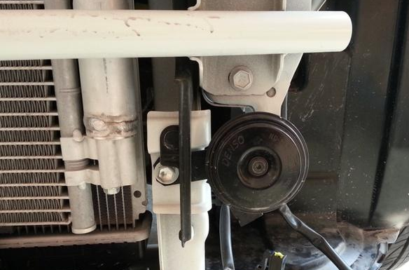
Minor Controls – contd.
Horn
A horn is sound making device used in Vehicle to warn of the vehicle’s approach or presence.
Loud horns and threatening sound horns should not be fitted in the vehicles.
Do not use horn unnecessarily.
Never use air horn in horn prohibited areas like within city limits, near hospitals, education institutions and offices etc.
Never blow horn near cyclists and animal drawn carts.
Do not fit two or more horns in a single vehicle and threaten others.
Do not blow horn continuously.
If there is an electrical defect and horn sounds continuously park the vehicle on the roadside and rectify the defect.
Notes:
Trainer Note:
No Honking Zones: Hospitals, Schools, Defense area, any other specified Area by Govt.
Where to Use: Hill area, blind curves, to register the presence of vehicle - where ever needed, at mandatory “Blow Horn” sign boards, during overtaking, in case of emergency.
Non OEM specific and any additional aftermarket fitted Horns not to be used.

Slide 30
Minor Controls – contd.
Direction Indicators
Use the indicators only you need them
Give enough time before changing direction and switch on indicators sufficiently before you change your course.
Cancel the indicator immediately once you have changed your course.
Never switch on right side indicator to allow some one to over take you. It is one of the wrong practice that is followed in our country.
Notes:
Trainer Notes:
1. Purpose of using Indicator Lights. (To indicate on Turning or Lane Change, U-turn & roundabout)
2. What is recommended distance for applying the Indicators? (Is it 50Mt., 100Mt., 150Mt., 200Mt.)
3. Please use the “Right direction” indicator to allow the vehicle coming from behind to overtake. (TRUE/FALSE)

Slide 31
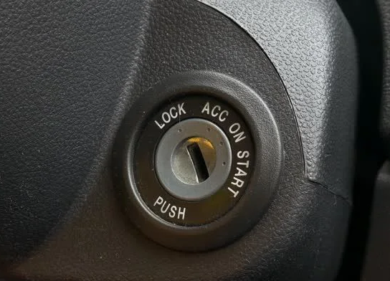
Minor Controls – contd.
Starter/Ignition Switch
Ignition Switch is used to start the engine.
Don’t use the starter switch, for more than five seconds at a time.
Give 30 seconds gap between each attempt.
Continuous usage of ignition switch can lead damage of starter motor and discharging of Vehicle Battery.
Notes:
Trainer Notes:
Why do you require 30 second gap between each attempt of ignition? (to prevent Battery’s sudden discharging & ensure vehicle starter system does not over heat, which may lead to damage)
Current Vehicle cannot be push started due electronic systems, hence battery, starter system should be maintained in good condition.

Slide 32
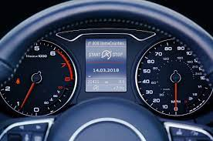
Minor Controls – contd.
Instrument Panel: The following are the contends of the instrument panel:
Tacho Meter
Oil pressure gauge/Indicator
Engine temperature gauge/Indicator
Ammeter/ Battery Charge Indicator Light
Speedo – meter, Odometer, Trip meter
Fuel gauge
Navigation LCD Screen with Vehicle Infotronics (where ever applicable)
Hazard warning switch
Electrical main line switch and other switches.
EBS switch
Tell tale indicators
Air Pressure gauge (where ever applicable & only in case of Vehicle with Air Brakes)
Notes:
Trainer Note:
Complete explanation on Instrument Panel, Tell tale indicators, & its functions.
What to check on instrument panel before engaging starter switch?
Difference between tachometer & speedo meter? (tachometer shows RPM of engine & speedometer show speed of vehicle)
Check Fuel Meter at Instrument panel before start of vehicle. (E=Empty/F=Full)

Slide 33
3. Pre-driving Checks
Notes:
Trainer Notes :-1) Details to be given of various things to be checked before the driver sits in the vehicle ( bumper 2 bumper ).
2) What all are the pre-driving checks ? ( instructor to ask the trainees)

Slide 34
Pre-driving Checks
A- VEHICLE PRE-CHECKS
FUEL LEVEL
RADIATOR WATER / COOLANT
TYRE PRESSURE
ENGINE OIL LEVEL
FAN BELT TENSION
WHEEL NUT,STEERING NUT TIGHTNESS ETC.
BATTERY CONNECTIONS
CLEAN FRONT AND REAR GLASS
CHECK OIL LEAK/ FUEL LEAK/ AIR LEAK & COOLANT LEAK
CHECK STEERING JOINTS, STEERING OIL,CAB & BODY
CHECK HEAD LIGHTS, WIPER MOTOR, INDICATOR,HORN & FUSES
CHECK BRAKE, CLUTCH PEDAL PLAY
CHECK INSTRUMENTS IN PANEL BOARDS.
CHECK ADBLUE LEVEL ( For Diesel Vehicle)
VEHICLE DOCUMENTS
CHECK SPARE WHEEL & TOOL KIT AVAILABILITY & THEIR CONDITIONS.
Notes:
Trainer Notes:-1) Explain the need & importance for conducting pre-checks on the vehicle.
2) The above vehicle prechecks are for LMV (car) and for LMV Commercial vehicle , additional points need to be covered ( at point no.6)
3) Trainer to explain the checking process of these items.
4) How many spare wheels are there in a vehicle ? ( 2,4,6,1)
5) What all should be there in Vehicle documents ? ( DL,RC,Ins,Fitness,Permit,PUC,Badge )

Slide 35
Pre-driving Checks
B – Before Boarding the Vehicle
1.Before Sitting on the Driver Seat
First aid box.
Warning triangle.
Fire extinguisher.
2. After Sitting on Seat
Driver seat Adjustment
Seat belt.
Setting of the rear view mirror.
Check for any foreign objects like bottles, loose items etc. near pedals.
Notes:
Trainer Notes :- 1) Trainer to explain the mandatory items to be made available in first aid box and its expiry date.
2) Fire Extinguisher expiry date /refilling date to be emphasized.
3) Spare fuses & Bulbs availability to be stressed.

Slide 36
Pre-driving Checks
B - After Boarding the Vehicle
3. Before starting the vehicle
Accelerator pedal.
Brake pedal.
Clutch pedal.
Steering wheel.
Gear shifting lever.
Hand Brake Lever
4. After Starting the Vehicle
All gauges & instruments on the dash board.
Functioning of all lights (Headlight, Indicators, Brake, Parking, Reverse)
Wiper motor & washer
Horn
Notes:
Trainer Notes:-1) Explain the normal movements of all the controls mentioned above.
2) To ensure that front wheels are in straight position using Steering wheel.
3) Whether the vehicle will start in any gear or in neutral only ?
4) What will happen to vehicle if the hand brake is engaged?
5) Explain the movement of steering wheel when it is in locked condition after removing the ignition key.

Slide 37
4. Beginning to Drive

Slide 38
Beginning to Drive
Precautions just before moving
Driver should learn how to sit in correct posture and road in front should be clearly visible.
Adjust your seat so that all controls are with in your easy reach.
Adjust rear view mirror.
Seat should be rigidly fixed, which should also allow all the adjustments also to operate.
Have your back to rest properly; this will help you to avoid back pain.
After attaining comfortable posture and before starting the vehicle, seat belt should be fastened.
Don’t allow any loose piece/ articles near driver seat; they may get stuck up in between pedals.
Notes:
Trainer Note:
Trainer to explain effects of wrong sitting posture & to explain simple exercises to overcome these.
Trainer to explain that driver seat to adjusted in such a way that maximum front visibility is there.
What is the correct Sitting angles? (60 deg., 75 deg., 90 deg.,105 deg.)

Slide 39
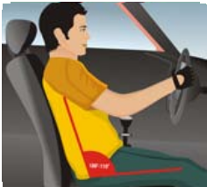
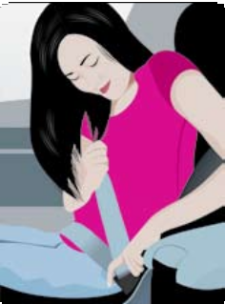
Beginning to Drive – Contd.
Sitting posture
Ensure comfortable sitting posture with firm lumbar support from seat’s back. Hands at steering wheel, elbows should be slightly bent. Do not sit erect or slouch on seat.
All the mirrors adjusted so that you can easily look in all directions.
Buckle up safety belt. Belt portion covering abdomen should be tight without any looseness.
In case of collision this factor is very important.
The upper portion of belt should be worn over the shoulder, never under the arm.
Some persons have a tendency to keep shoulder belt pulled away from chest, this can be fatal in case of collision.
Notes:
Trainer Note:
Trainer to explain about the proper steering holding position. (clock position of 9-3)
Importance of Head Rest and its proper adjustment.

Slide 40
Beginning to Drive – Contd.
Starting the engine
Before starting the engine ensure that hand brake is engaged, vehicle is in neutral.
It is a good practice to press clutch pedal during cranking of engine.
While cranking do not press accelerator as starting will become difficult.
Do not crank more that 3-4 seconds at a stretch.
If engine does not start try again after 30 seconds.
After engine has started look at instrument cluster to check if any warning light has come on.
Notes:
Trainer Notes:
Sequence of starting the Vehicle to be explained.
Do’s & Don’ts before and after cranking the engine to be explained.
What will happen if you crank continuously? ( Starter Motor fail, Wiper Motor Fail, Battery discharge, Nothing will Happen).
What will happen if accelerator pedal is pressed during cranking? ( Fuel over flooding in cylinder, which will hinder vehicle starting)

Slide 41
Beginning to Drive – Contd.
Moving off
Ensure that parking brake is engaged, press clutch pedal fully with your left foot and keep the brake pedal pressed with your right foot.
Engage 1st gear. Start releasing clutch pedal till the point you hear the sound of engine changing.
At this point when you see the hood portion of car rising a bit, hold steady the clutch pedal.
Release right foot from Brake pedal & Release Parking Brake.
Vehicle will start moving forward slightly.
Release clutch pedal slowly while pressing accelerator gradually
This synchronization of parking brake lever, clutch pedal and accelerator requires a good amount of practice, so be patient if your vehicle stalls or moves off with jerks.
A smooth take off without rolling back of vehicle indicates you have mastered the first step.
Notes:
Trainer Notes:
1. Trainer to explain Friction of Clutch Biting & Balance Point briefly.
2. Trainer to explain harm in driving while clutch being partially pressed.
3. What does clutch pedal do? ( engage/disengage Gears with Engine/ stop the vehicle/ pedal for foot resting)

Slide 42
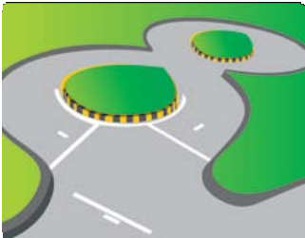
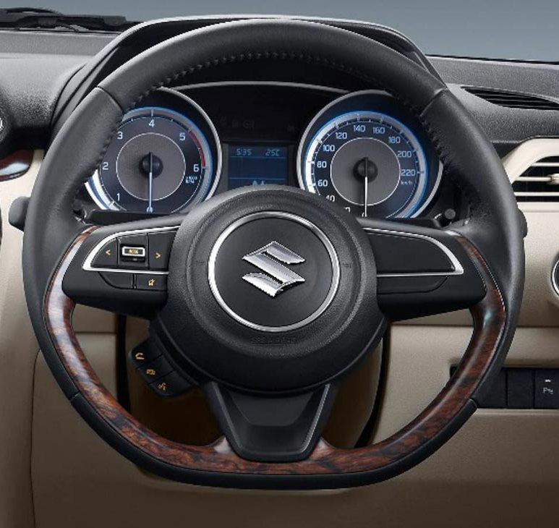
Beginning to Drive – Contd.
Using steering
Steering is used to control the direction of the vehicle in motion as per the shape of the road.
Teach how to drive vehicle in straight line & within the road marking, without hitting or rubbing the Kerb Stones
Teach how to make Left/Right turn by following all traffic rules for making turns.
Practicing on how to drive on Left/Right Curves/round about.
Practicing on difficult terrains like “S” bend, “8” Bend, Traffic Police Check, barriers, etc.
You will be able to experience the steering effect and how to return after completing turn on one side.
Notes:
Trainer Note:
Trainer to explain on how to hold steering wheel. (9-3 Left/Right clock position)
Trainer to explain not to criss – cross the hands while negotiating turns.
Never use single hand to hold the steering while driving, except the time of Gear change or operating any control switches.
Driver can turn steering of vehicle in stationary and Off condition? (YES/NO)

Slide 43
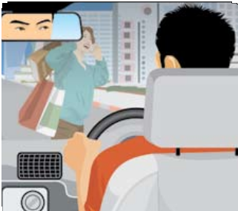
Beginning to Drive – Contd.
Stopping your vehicle & Emergency stop
For stopping a vehicle, driver to slowly move the vehicle to the extreme left land by giving Left indicator signal, also looking into the mirrors
To practice stopping you need to experience the effect of brake pedal effort and consequent slowing down of the vehicle.
Before stopping look into mirrors, over the shoulders if it is safe to stop.
Now press brake pedal gently first and progressively increase the pressure.
As the vehicle starts slowing down, engine starts giving knocking sound, at this point press clutch to prevent stalling.
After the vehicle stops completely, bring the gear lever to neutral and engage parking brake.
In case of emergency:
you need to respond very fast,
- apply brake first as the speed gets reduced then press clutch.
Stay calm, do not panic, hold the steering wheel tightly
Notes:
Trainer notes:
1. Do not suddenly press brake pedal for slowing and stopping the vehicle.
2. While driving on first and reverse gear trainer should explain to press clutch pedal first and then the brake pedal. This is done to prevent the stopping of Engine.
Questions:
Which foot to be used for Clutch, Brake and Accelerator pedal?
Which mirror to be seen while moving the vehicle to extreme left side (Right / Left / Center / All)

Slide 44
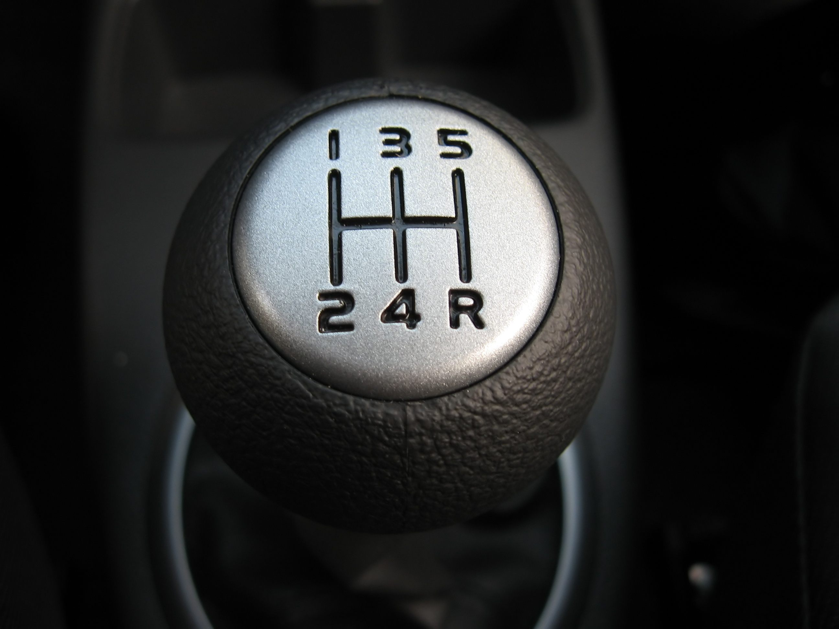
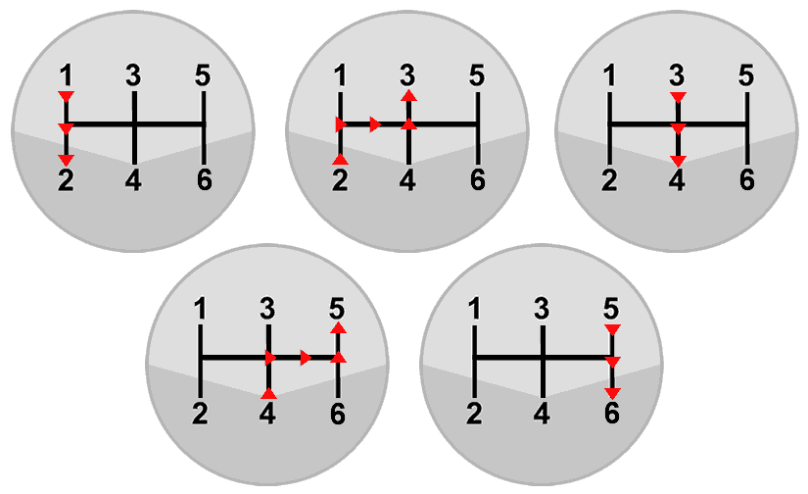
Beginning to Drive – Contd.
Gear changing
Always engage first gear to move the vehicle
Select the appropriate gear with respect to vehicle speed & traffic condition
Shift the gears in sequence without jumping (like second to fourth)
Wrong gear selection will lead to higher fuel consumption and possible
damage to Engine and Gearbox
Don’t shift the gear in partial engagement of Clutch
Don’t slam / bang the gear lever while shifting
Notes:
Trainer notes:
Do not look at the gear changing lever while shifting gears, always have eyes on the road
Gear shifting to be done as per the pressure point
Speed control is important skill, you need to learn in the city traffic.
During peak hour traffic you may have to drive your vehicle in start- stop condition.
To control your vehicle you need to select the right gear and do not press clutch to reduce speed, this will increase fuel consumption and wear & tear of clutch system.
What is correct sequence of Gear shifting in car? (1-2-3-4-5/1-2-4-3-5/1-2-3-5)

Slide 45
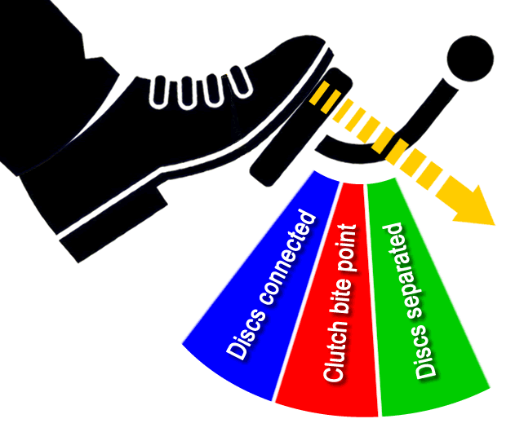
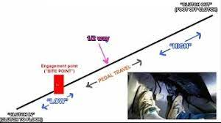
Beginning to Drive – Contd.
Clutch Biting Point
As you engage the first Gear & release the clutch pedal from the fully pressed condition slowly, at one particular point the engine sound changes.
This is the point at which the clutch plate slowly start engaging with the engine fly wheel, but it has not yet fully engaged so as to move the vehicle.
This particular point is Clutch Biting Point.
Clutch Balance Point
After the biting point, on slightly releasing the clutch pedal the clutch starts joining with the gear box, but not to the extent of move the vehicle.
This point is known as balance point.
Notes:
Trainer Note:
Does the Vehicle start moving at Clutch Biting Point? (YES/NO)
Does the vehicle start moving at clutch Balancing Point? (YES/NO)

Slide 46
5. Driving on the Road

Slide 47
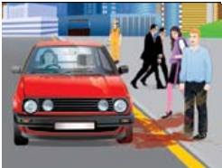
Driving on the Road
Most of the roads we use in cities have mixed traffic i.e. it is a combination of pedestrians, cyclists, bullock carts, heavy vehicles like trucks, buses besides two-wheelers and cars etc. Since most of roads lack segregation, driving becomes a challenging task. Still you have to remain cool and save yourself and others to avoid unnecessary harassment later.
Notes:
Trainer Notes:-
Who all are the road users

Slide 48
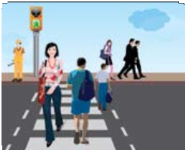
Driving on the Road
Pedestrians:
Statistics have proved that most of the victims of road accidents are pedestrians. Be careful with them as:
Pedestrians may come on road suddenly due to lack of footpaths.
Many pedestrians prefer to cross the road wherever they want.
They may appear suddenly from behind parked cars, busses etc.
On traffic signal when you are waiting for light to turn green some people may try to run and cross the road.
Children involved in begging may come out from between cars.
Ensure safety of elderly or handicapped people as they may not be fast enough to cross the road. Aged people tend to be indecisive on road, they may stop suddenly or turn back while children and younger people try to rush through. Allow pedestrians to cross.
During rainy season ensure you do not splash water on them.
In dark, many pedestrians may not be visible easily due to dark coloured clothes.
Notes:
Trainer Notes:-
Trainer need to explain to the driver, about the overtaking is prohibited at pedestrian crossing.
Trainer to explain on right of way at Zebra crossing (Pedestrians).

Slide 49
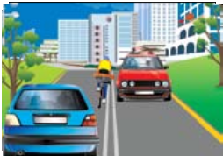
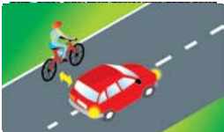
Driving on the Road
Cyclists, Cycle Rickshaws, Animal Drawn Vehicles
The second largest group involved in road accidents is cyclists. They normally lack any formal traffic education as Motor Vehicle Act does not apply on them so they may behave recklessly endangering their lives and other’s. In absence of separate cycle track they also use the road meant for automobiles. Take following precautions:
Cyclists may come in your way while avoiding pot holes or other obstructions on the road.
On crossings they have a tendency to weave through stopped vehicles to come to front so leave sufficient space around your car to save it from scratches and damages.
They may turn suddenly without giving any signal or looking at traffic.
Notes:
Trainers Notes:-
Trainer needs to explain that the most of the cyclists don’t follow the road rules.
Which side of the road, cyclist should ride? (Extreme left, Centre, Extreme right)

Slide 50
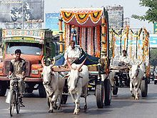
Driving on the Road
Cyclists, Cycle Rickshaws, Animal Drawn Vehicles – contd.
4. They being very unstable may fall on bonnet of your car so take care to keep safe distance when overtaking them.
5. As normally cyclists will remain on the left most lane, you have to be careful while negotiating a left turn. You may misjudge time taken to slowdown and they may collide with you. Do not overtake them while taking left turn, let them pass first.
6. During night they may not be visible on road easily as they do not use any lamp, reflector & reflective clothing.
Follow same set of precautions for Cycle Rickshaw, Animal Drawn Vehicles as mentioned for pedestrians and cyclists.
Notes:
Trainers Notes:-
Trainer needs to explain that the most of the cyclists don’t follow the road rules.
Which side of the road, cyclist should ride? (Extreme left, Centre, Extreme right)

Slide 51
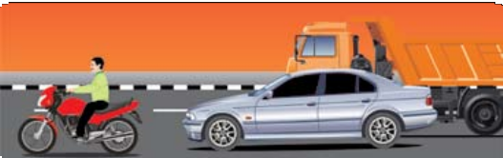
Driving on the Road
Encountering Other Road Users
Scooters and Motorcycles: Maximum fatalities are faced by this group in case of accidents. Modern scooters and motorcycles are very powerful vehicles but still vulnerable due to lack of balance. Keep following in mind:
They can move very fast so they have a tendency to weave through lanes.
Be very careful while moving to left lane/taking left turn as they prefer to overtake from left side of the traffic.
A motorcyclist may suddenly swerve or may lose balance if encountered with rough road or punctured tyre
Have tendency to drift towards you & other vehicles on the road. Mild sound of horn to warn
Sometimes they may surprise you with their horn as now they sound very similar to car’s. Be mentally prepared to remain cool in case of harsh horn.
While overtaking sound them with horn as many of them may not have rear view mirrors installed on their bikes.
While overtaking also ensure you do not splash water on them during rains.
On rough roads overtake them carefully as they may fall or skid.
They may come from opposite direction suddenly at high speed. Normally happens around petrol pumps or where there is no gap in verge to go to opposite road.
Notes:
Trainers Note:-
1. Behavior of scooter riders on road?
2. What are the precautions to be taken when found motorcyclist on road?
3. The Trainer to explain the latest statistics of road accidents of scooterist?
4. Trainer to explain on truck drivers to respect other road users irrespective of size of the vehicle while overtaking (especially two wheelers).

Slide 52
6. Driving at Intersections

Slide 53
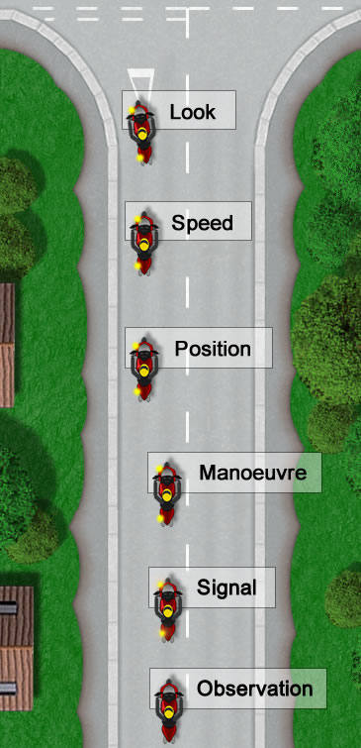
MSM PSL ROUTINES - MSM PSL rules
MSM - PSL RULES:
Whenever a driver stops his vehicle or moves it or change his course while driving, he or she should follow an important safety rule known as MSM - PSL rule.
By strictly following this rule the driver can avert an accident easily. This is one of the basic rules for all the drivers using the road.
MSM means: PSL means :
M - Mirror P - Position
S – Signal S - Speed
M- Manoeuvre L - Look
Mirror
Notes:
Trainer Note:
1. Trainer to explain on MSM – PSL & its importance

Slide 54
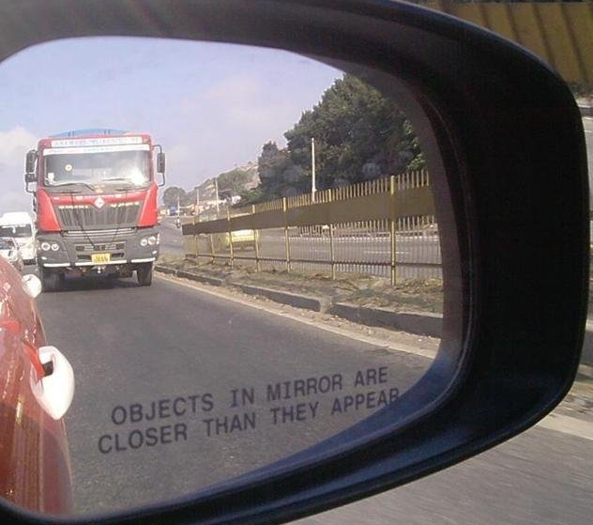
MSM PSL ROUTINES - MSM PSL rules
M- Mirror
The rear view mirror
Before changing the direction of the vehicle, the driver should look in the rear / side view mirror given in the vehicle
If in the mirror it shows that a vehicle from behind is coming from rapidly and nearby, then let the vehicle pass.

Slide 55
MSM PSL ROUTINES - MSM PSL rules
S - Signal
The following signals shall be used by the drivers of all motor vehicles, namely:
When about to slow down, a driver shall extend his right arm with the palm downward and to the right of the vehicle and shall move the arm so extended up and down several times in such a manner that the signal can be seen by the driver of any vehicle who may be behind him.
When about to stop, a driver shall raise his right forearm vertically outside of and to the right of the vehicle, palm to the right.
Notes:
Trainer Note:
Trainer to explain on Hand signals to be given by the driver.
Slow Down
About to stop.

Slide 56
MSM PSL ROUTINES - MSM PSL rules
S – Signal (Contd.)
(c) When about to turn to the right or to drive to the right-hand side of the road in order to pass another vehicle or for any other purpose, a driver shall extend his right arm in a horizontal position outside of and to the right of his vehicle with the palm of the hand turned to the front
(d) When about to turn to the left or to drive to the left-hand side of the road, a driver shall extend his right arm and rotate in an anti-clockwise direction
(e) When a driver wishes to indicate to the driver of a vehicle behind him that he desires that driver to overtake him he shall extend his right arm and hand horizontally outside of and to the right of the vehicle and shall bring the arm backward and forward in a semi-circular motion.
Notes:
Trainer Note:
Trainer to explain on Hand signals to be given by the driver.
About to turn right.
About to turn left
Indicate (permission) the driver behind to overtake

Slide 57
MSM PSL ROUTINES - MSM PSL rules
S – Signals (contd.)
Direction indicator
The signals referred to in Regulation 12, may be simplified also by mechanical or electrical devices.
a) For slowing down : Brake light
b) About to stop : Brake light
c) Drive to the right or turn to the right : Right side indicator
d) Drive to the left or turn to the left : Left side indicator
e) Allowing to overtake : No indicator
f) Hazard warning indicator (all indicators) : When parked on the road due to unavoidable problem
Notes:
Trainer Note:
Trainer to explain on Direction Indicators (mechanical/Electrical devices) to be given by the driver

Slide 58
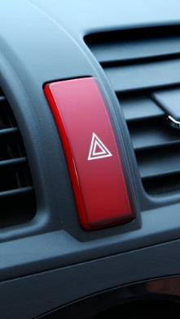
MSM PSL ROUTINES - MSM PSL rules
S – Signals (contd.)
Hazard warning Switch
Hazard warning Indicator
Notes:
Trainer Note:
Trainer to explain when to use Hazard Warning indicators. (during vehicle break downs & while moving vehicle to workshop)
Hazard warning should not be used while driving in rainy / fog conditions.

Slide 59
MSM PSL ROUTINES - MSM PSL rules
M - Maneuver
Deftly and efficiently drive the vehicle
The tricks & skills of moving the vehicle , at the time of driving, turning, while pausing or moving your vehicle in front of another vehicle or while standing a vehicle.
While manoeuvring the vehicle, the driver should take care of the vehicles and road conditions ahead or behind their vehicle.
Notes:
Trainer Note:
1. Trainer to explain on manoeuvring and be safe and follow traffic rules while doing the same.

Slide 60
MSM PSL ROUTINES - MSM PSL rules
P – Position
Position means that the vehicle is in a safe or in place, whether it is on the road or at some other place.
While standing in a fixed position, the vehicle should stand on the left as much as possible and from this situation, other vehicles should not have any kind of obstruction.
More caution should be taken for longer vehicles.
When turning the vehicle in the left, the vehicle should be right as far as possible on the road.
Keep your vehicle's variables and a safe distance and your vehicle's condition should always be such that you can see others and others can see you.
Notes:
Trainer Note:- 1. How to take position of vehicle while merging or demerging on road?
2. Which of the following to be first action while taking position? (Speed/Look at the mirror/Maneuver)
3. Why more precautions needs to be taken for longer vehicles? (Due to more turning radius for longer vehicles it needs larger space while turnings)

Slide 61
MSM PSL ROUTINES - MSM PSL rules
S – Speed
At the speed here means that select the right speed when the vehicle is in the correct position.
To reduce the speed of the vehicle means the speed of the vehicle should be slow to stop the vehicle.
Remove or exert foot pressure on accelerator pedal to reduce / increase the speed & use the brakes if the vehicle has to slowed / stopped rapidly.
One has to consider surrounding traffic (vehicles coming from behind) as sudden braking can cause a hit.
To avoid this, apply the brakes slowly, so that the driver of the vehicle coming from behind gets alert.
Notes:
Trainer Notes:- 1. Trainer has to explain about the importance of picking up appropriate speed as soon as he enters into main lane to avoid rear end collision with other vehicles.

Slide 62
MSM PSL ROUTINES - MSM PSL rules
L – Look
While stopping the vehicle, see that where the vehicle has to stop, so that there is no obstruction or inconvenience to others.
When driving, keep in mind that you are in the right place and on the road.
Here the MSM-PSL rules should be the fundamental for drivers, with which many accidents can be avoided.
Notes:
Trainer Note:- 1. Trainer to explain precautions to be taken by driver before stopping vehicle

Slide 63
MSM PSL ROUTINES - MSM PSL rules
L
L
L
L
6
6
6
6
S
S
S
S
5
5
5
5
P
4
P
P
P
4
4
4
3
3
3
M
3
M
M
M
S
2
S
S
S
2
2
2
M
1
M
M
M
1
1
1
M.S.M.P.S.L in Various Situation
Notes:
Trainer Note:
1. Trainer to explain the picture

Slide 64
MSM PSL ROUTINES - MSM PSL rules
Signals to be given by drivers
The following signals shall be used by the drivers of all motor vehicles, namely :
(a) When about to slow down, a driver shall extend his right arm with the palm downward and to the right of the vehicle and shall move the arm so extended up and down several times in such a manner that the signal can be seen by the driver of any vehicle who may be behind him.
When about to stop, a driver shall raise his right forearm vertically outside of and to the right of the vehicle, palm to the right.
2

Slide 65
MSM PSL ROUTINES - MSM PSL rules
(c ) When about to turn to the right or to drive to the right-hand side of the road in order to pass another vehicle or for any other purpose, a driver shall extend his right arm in a horizontal position outside of and to the right of his vehicle with the palm of the hand turned to the front.
When about to turn to the left or to drive to the left-hand side of the road, a driver shall extend his right arm and rotate in an anti-clockwise direction.
When a driver wishes to indicate to the driver of a vehicle behind him that he desires that driver to overtake him he shall extend his right arm and hand horizontally outside of and to the right of the vehicle and shall bring the arm backward and forward in a semi-circular motion.
2

Slide 66
7. Manoeuvres

Slide 67
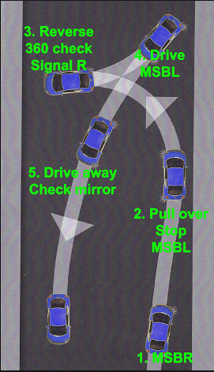
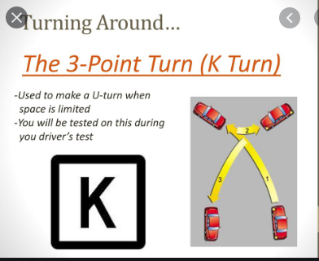
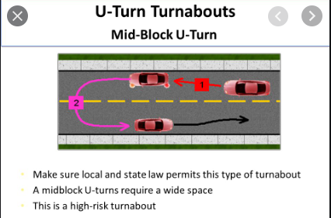
Manoeuvres :- 5 , 3 point and U turn
Notes:
Trainer Note:-
Trainer to explain the importance of practicing 3 turn & 5 turn points to negotiate the narrow roads while doing such activities.
Trainer to demonstrate practically 3 & 5 point turns on ground

Slide 68
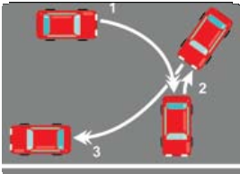
Manoeuvres
Rules of the Road
U - Turn
U-turn is the maneuver when you have to move your vehicle to other side of the road. This maneuver may have to be carried out on a road with or without a divider.
On busy crossings normally U-turn is not allowed.
During U-turn follow these steps:
Look around in all mirrors, look over your shoulders, give right turn signal.
When absolutely sure there is no traffic on both sides of the road, start turning the steering while slowly moving off.
If the road is not sufficiently wide enough you have to stop while you reach to other side of the road. As you approach the end of the road, start turning steering to the left.
Put the vehicle in reverse gear start moving off backwards, as soon as you have reversed sufficiently start taking right turn.
Complete the maneuver and move off in opposite direction after looking carefully into mirrors.
Notes:
Trainers Note:-
1. On a road with the divider it is easier to take U-turn as you have to look for other traffic from one side only but on a road without divider you have to ensure there is no traffic approaching on both sides, during the maneuver.

Slide 69
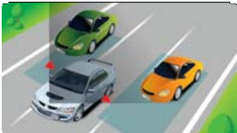
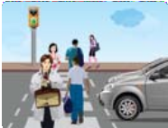
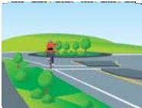
Manoeuvres
Mirror Blind Spot
All mirrors have blind spots as shown. In these location vehicles, bikes etc. will not be visible to you while turning or changing lanes one has to ensure that no vehicle/bike is in the blind spot.
To overcome these blind spots you need to look over your respective shoulder before completing the maneuver. You can use blind spot mirror also. You also have to ensure that you do not drive in the blind spot of other vehicles.
Right of Way:
Each of us using the roads has right of way at particular situations or
locations. To keep traffic smooth and in the interest of all road users we should be giving right of way instead of assuming it.
Pedestrians have right of way on zebra crossing
Cyclists on cycle track
Notes:
Trainers Note:-
Trainer has to explain the blind spot areas & angles.
How to adjust mirror and fit the additional mirrors, cameras to minimize the blind spot area
Trainer to explain about the right of way at various locations on the road (pedestrians crossings, circles)

Slide 70
Manoeuvres
Overtaking:
While over taking follow up MSM/ PSL rules.
Do not follow closely and don’t come to your right suddenly to overtake. You should come to the right lane well in advance and this will help you better to observe the on coming traffic.
Alert the vehicle going in front of your vehicle by blowing horn in day times and dipping the headlights in night-time. This will caution the driver to give you space to over take.
If there is a vehicle coming in the opposite side or any obstructions are seen in the road follow IPDE principle for safety. Unless the other driver is properly cautioned you should not make an attempt to overtake.
The over taking should be done quickly and correctly. Do not come to the left immediately after overtaking; look at the left mirror and after ensuring the vehicle has safely over taken smoothly come to your left.
While over taking a parked vehicle more care should be taken.
2
Notes:
Trainers Notes:
Explain MSMPSL & IPDE rule used for overtaking
Trainer to explain about the wrong practices being used on road while overtaking to prevent the accidents (indicator flashing, head lights flashing etc.)

Slide 71
Manoeuvres
Being Overtaken:
The driver who is allowing the other driver to overtake has equal responsibility as overtaking.
Before allowing the driver behind to over take you, ensure the road is clear and give signal to over take you.
When the vehicles behind increase the speed and in the process of over taking NEVER try to increase the speed of your vehicle .
If the vehicle desiring to over take you requires more gap, slightly reduce the speed of your vehicle give him enough space to over take.
If any drivers make a wrong prediction and try to over take when there is no enough space pull to your left in the interest of your safety.
There is wrong practice being followed during night driving: if a vehicle signal the opposite vehicle asking way to over take, the driver in the front vehicle switches on the right indicator and allows him to pass. This is basically wrong - when you switch on right indicator it means that you will make a right turn or you will change to right lane. It is wrongly under stood and followed by innocence drivers that right indicator as a over taking signal. This wrong practice should be stopped immediately.
2
Notes:
Trainers Note:-
Trainer to explain the steps to be followed by the driver for being overtaken
Trainer to explain on responsibility of the driver for being ethical

Slide 72
Manoeuvres
Places where overtaking should not be done:
If there is no sufficient gap in the road ahead don’t try overtaking.
NEVER attempt to overtake in Road- bends
Do not over take at Railway-level crossings and Road-junctions.
When a vehicle in your front is already over taking a vehicle do not attempt to over take as a third vehicle attempting to over take both the vehicle.
Three in one line across the road is very dangerous.
Do not over take from left.
When the driver in the front makes a signal not to over take during that time you should not try to over take.
Wherever there is a caution board, alerting you to reduce your speed, do not try to over take in these areas. In case over taking is to be done, you should do it with more caution.
Notes:
Trainers Notes:-
Trainer to discuss about the places where overtaking is not to be done with examples
Why should we don’t overtake at railway level crossings? Ans. Road width at railway crossings is narrow hence there are chances of accidents are more.

Slide 73
Manoeuvres
Places where overtaking should not be done:
Do not over take at dawns, snowfall and fags, rainy times when the visibility is poor.
Do not over take a yellow line or a continuously marked white line.
When a vehicle is waiting at the pedestrian crossing do not over take at that juncture.
Even if you a slight doubts, do not over take.
If there is a sign board prohibiting overtaking, do not over take.
If you have a doubt that the vehicle in the opposite direction will come before you over take do not try to over take.
Do not over take at the brew of a hill or a blind turning.
Do not over take at gradients slopping upwards. There will be no visibility of the on coming traffic.
2
Notes:
Trainers Notes:-
Trainer to discuss about the places where overtaking is not to be done with examples

Slide 74
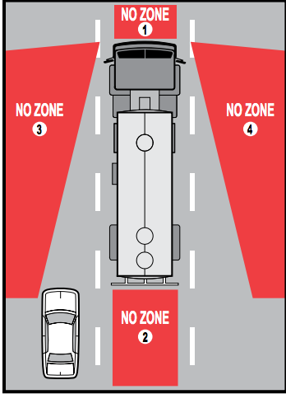
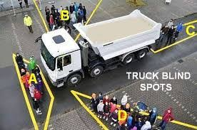
Blind Spot :The exact size and location of your trucks blind spot is affected by your windscreen, dashboard and pillars as well as any passengers or cargo that you might have in the vehicle. However, the rough location is outlined by the diagram below.
Manoeuvres
Notes:
Trainer Note:
1. Trainer to explain the Picture

Slide 75
8. Reversing

Slide 76
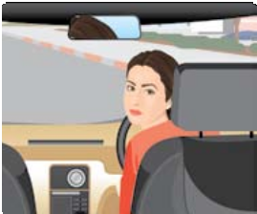
Reversing
Rules of the Road
Reversing: Driving in reverse gear may be necessary when you are stuck in narrow lane or a road with a dead end. Driving in reverse gear has certain difficulties:
You have more blind areas as in reverse gear you actually come to rear of the driver cabin.
As you twist your neck your visibility is reduced to one side of the body.
During driving in reverse gear, steering becomes more sensitive, turning radius actually gets reduced.
To safely drive in reverse gear, look around in all the three mirrors, look over both side shoulders, hold the back of left front seat and turn towards back and start moving.
Occasionally take out your neck from the window to have clear view. It is advisable to take help of someone to guide you through the obstacles.
Always avoid reversing into a major road from a minor road as you will be able to see the road only after 75% length of your vehicle is already on the road. Ask for guidance, if you are stuck in such a tricky situation. Drive slower than you normally drive in 1st gear.
Notes:
Trainers Note:-
Trainer to explain on the limitations to move the vehicle on reverse direction on main road.
While driving in reverse direction, driver is suppose to_____
Look in rear view mirror 2. Look above the shoulder 3. take help of others if required 4. All of the above
The modern vehicles comes with reverse camera which assists the driver while reversing the vehicle

Slide 77
9.Parking

Slide 78
Parking
Types of Parking:
Angular,
Parallel,
Perpendicular
Hill Parking
- Downhill
- Uphill
Notes:
Trainer Notes:-
1. What are the different types of parking?

Slide 79
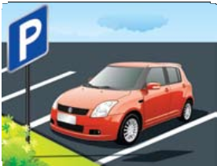

Parking
Rules of the Road
Parking: Following points to be kept in mind while parking your vehicle:
Try to park vehicle in identified parking zone only.
Do not park in No Parking zone.
Parking near the gap in verge for taking U-turn may cause accidents as the vehicle taking U-turn will not be able to complete the maneuver.
In case it is to be parked in an area where there are no clear directions, park your vehicle in the direction of traffic, make sure it does not obstruct traffic, should not block passage to buildings.
Do not park your vehicle close to other vehicle or its passage gets blocked. Should be able to see tyres of vehicle in front while parking, this insures sufficient space to move out.
Park your vehicle as close as possible to the kerb.
Notes:
Trainers Notes:-
1. Trainer to explain do’s & don’ts of parking of vehicle at various places.

Slide 80

Parking
Rules of the Road
Parking – contd.: Following points to be kept in mind while parking your vehicle:
7. Pull handbrake firmly and keep vehicle in gear so that it does not roll accidentally.
8. If parking on uphill ensure that you turn the steering towards right side, when parking downhill park the vehicle with wheels turned towards left side kerb. This will ensure that if vehicle rolls accidently vehicle will come to an automatic stop immediately.
9. When parking in dark area, where it may be dangerous for vehicles coming from behind, switch on hazard lamp to warn other users of the road.
10. Do not park vehicles over heap of dry leaves as these may catch fire from catalyzer heat.
11. Do not sit in parked cars with A/C on in closed spaces like garages
Notes:
Trainers Notes:-
1. Trainer to explain do’s & don’ts of parking of vehicle at various places.

Slide 81

Parking
Rules of the Road
Parking method can be classified as:
Parallel parking
Angular parking
Perpendicular parking
Parallel Parking: You need about 2 meters more space than the length of your car to safely park the vehicle. In tighter spaces it is advisable to use reverse parking method as it provides deeper steering angle. In tighter slots trying to park in front direction will prove difficult.
Locate the slot for parking, stop your vehicle parallel to the parked car by keeping a gap of 2-3 feet or ½ Meters.
Start reversing as your mirror reaches around rear of the parked car, turn steering wheel anticlockwise fully. Be aware that now your vehicle’s right front end fully protruding on the road against traffic.
As your vehicle’s rear right corner comes in line of right front corner of the car parked in rear, start turning the steering clockwise.
Stop the vehicle when your car reaches near to the car parked in rear.
Turn the steering to straight position and move the vehicle ahead so that your vehicle comes in center of the available space while straightening up the wheels.
Notes:
Trainers Notes:-
Where do use parallel parking?
Explain on parallel Parking

Slide 82


Parking
Rules of the Road
Angular Parking:
This kind of parking is normally employed in parking lots of offices, shopping malls etc. Normally you will get clear cut painted boxes to guide you. Try to park the vehicle in centre of the box. On locating a vacant slot you can easily park in the slot in one go.
While coming out of slot be careful as your vision of the road gets blocked due to parked cars. Very slowly come out of slot, when your view of road gets cleared you can turn the vehicle if it is safe. Do not try to park in reverse.
Perpendicular Parking:
It is advisable to park in reverse while entering perpendicular parking. This is also very common type of parking you will come across in offices, underground parking etc.
Pull up to the parked vehicle next to your intended slot, reverse
slowly into the vacant slot while straightening up. If the vehicle does not come in the centre bring the vehicle forward, reverse into slot correcting the position.
Notes:
Trainers Notes:-
Where do you use the angular parking? Ans. Offices, Shopping malls etc.
Which is most common type of parking? Ans. Perpendicular Parking

Slide 83

Parking
Hill Parking ( Down Hill / Up Hill
1. When parking downhill, with or without a curb, the front wheels should always be turned to the right.
2. When parking uphill, with a curb, the front wheels should always be turned to the left.
3. When parking uphill, without a curb, single unit vehicles should always have their front wheels turned to the right.
Notes:
Trainer Notes:-
Explain the parking techniques while uphill or down hill parking?

Slide 84

Parking
NEVER PARK the vehicle if your vehicle would cause an obstruction to the traffic or to the other road users. Such parking are even prohibited by the law.
No Parking places
Where “ No parking “ caution boards are kept..
Near road junctions.
With in 10 meters distance where road signboards are kept- the vehicle should not cover a signboard.
Near pedestrian crossings, rail way crossings , in front of hospitals, schools, police stations, fire stations, ambulance stations and entrance of other buildings.
Near bus stops.
In front of private roads.
In narrow roads.
In such a way it may affect to take a vehicle out which is already parked.(Double parking).
If the roadsides are marked with yellow lines indicating no parking.
On the right side of the road.
Parking opposite to a vehicle.
Road repair areas.
Snow covered areas.
Notes:
Trainers Notes:-
1. Explain no parking areas.

Slide 85
Parking
Correct- Parking
Park the vehicle in places, where parking is allowed.
PARK THE VEHICLE IN THE DIRECTION OF TRAFFIC FLOW.
If parking bays are marked, park the vehicle accordingly.
If you have to park at the roadside, you should always park parallel and close to the kerb or edge of the road. Park on the shoulder wherever possible.
Apply parking brakes.
In down hill slopes, if there is barricades, keep the front wheels turned towards left-facing the barricade. If there is no barricade, keep wheel chokes in the rear wheels.
In uphill gradients, turn the front wheel towards right, keep wheel chokes in the rear wheels.
While parking ensure doors are properly locked.
While getting down from the vehicle after parking, carefully look at both the sides, while opening the door to get down.
Use parking lights in night times.
2
Notes:
Trainers Notes:
1. Trainer to explain the correct parking areas & methods?

Slide 86
10. Driver’s Responsibility
Driving behavior.
Consideration for other road users, courtesy and competitiveness.
Over-confidence.
Defensive driving.
Railway crossing
Right - of – Way - Driving through.
Notes:
Trainers Note:-
1. What are the responsibilities of driver?

Slide 87
D R I V E R
D DISCIPLINE
R RESPECT
I INTELLIGENT
V VIRTUE
E ENDURANCE
R RESPONSIBILITY
Notes:
Trainer Notes:-
What is the definition of driver?
Explain the meaning of each abbreviated word in regional language.

Slide 88
Qualities of a Good Driver
Responsibility
Self Safety
Passengers Safety
Other Road Users Safety
Safety of the Goods Carry Vehicle
2. Concentration
Concentrate Only in Driving
Don’t Use Cell Phone
Don’t Speak With Any One
Don’t Drive Unhealthy Condition
Notes:
Trainer Note:
1.What are the qualities of a good Driver?
2. Why is concentration and being responsible important while driving?

Slide 89
Qualities of a Good Driver
3. Anticipation
Be alert near School & College
Keep watch on animals crossing the road
At Road Junctions
Near Pedestrians Crossing
In Blind Corners
4. Patience
Patience in Traffic
Don’t Race With Any Vehicle
Don’t Teach To Any Driver When He is wrong
Notes:
Trainer Note:
1.Why does Driver need patience while driving?

Slide 90
Qualities of a Good Driver
5. Confidence
Have Confidence
Don’t Build up Over Confidence
Practice / Experience Make Man Perfect
6. Adherence To The Traffic Rules
Safety First
Know About Motor Vehicle Act & Rules
Take Training In Good Training Centre
Self Control
Notes:
Trainer Note:
1.Why it is required to adhere to traffic Rules?
2. Why is concentration and being responsible important while driving?

Slide 91
Qualities of a Good Driver
7. Vehicle Knowledge
Vehicle aggregates
How To Control Vehicle In Abnormal Conditions
Vehicle Maintenance
Repair The Minor Problems
8. Consideration
Give Up
Go With Rules Of Road
Go With Road Local Culture
Notes:
Trainer Note:
1.What are main vehicle aggregates? (Engine, Transmission, suspension, chassis, steering, Braking system, electrical system & AC)
2. Importance of Routine vehicle maintenance schedule.

Slide 92
A good driver always understands the road signs and obeys them. It is essential to follow road rules & regulations.
Not following traffic rules and ignoring the traffic signs is punishable under M.V. Act 1988.
Always keep to the left.
Driver must possess a valid driving license & when demanded by an officer, the driving license should be shown for inspection.
The driver should keep the R.C. book, insurance certificate, tax certificate, PUC certificate etc. in the vehicle.
Do not throw cigarette butts, wrappers, empty tins on road while driving.
Do not leap your head, hands through the widows when the vehicle is running; also do not allow any other articles to project out side the vehicle.
Do not use the horn unnecessarily. Loud noise will irritate others.
Good driving Habits
2
Notes:
Trainers Note:-
1. What are the documents to be carried while driving? Dos & don’ts.

Slide 93
Good driving Habits
If a vehicle in the opposite direction approaches you dangerously and deliberately, do not behave in the same manner and control your self to prevent accident.
Approach the vehicles with ‘L’ board more carefully and give more gap for these vehicles.
Show courtesy for blind and handicapped when they are crossing the road. They can not cross the road like others.
If an emergency vehicle is approaching with siren and dome light, like police, ambulance and fire brigade you must pull your vehicle to the extreme left possible or even stop in extreme left of the road until the emergency vehicle pass.
Do not drive with emotions and hard feelings like anger, hatred etc. Cool down your self first and then start driving. You should have full concentration on the road while driving.
2
Notes:
Trainers Note:-
1. Dos & don’ts for good driving?

Slide 94
Good driving Habits
Do not throw bright light on the vehicle coming in the opposite direction and glare the eyes.
In case of any road accident and stopped by police, you should stop and wait there till the enquiry is over, even if you are not responsible for that accident.
You should give your name and address and get the other driver’s name and address during accidents..
If you happen to see any accident victims, please try to help them by doing first- aid or help to admit them in the nearest hospital. You can arrange for ambulance or inform the nearest police station.
Always keep a first aid kit with the vehicle.
2
Notes:
Trainers Note:-
1. What to do in case you witness an accident?

Slide 95
Good driving Habits
No hindrance to be there around Driver and Driver area.
Always obey traffic signals & Road Signs.
In the zebra crossings give priority to pedestrians to cross.
Do not allow any loose items in the cab.
Check for any object (animal, etc.) around & under vehicle before starting.
Never exceed mentioned speed limit.
Keep an eye on the instrument panel and all gauges.
In case of Tyre puncture, use OEM recommended Jack & tools & process.
In case of breakdown, try to bring the vehicle on left side of road, engage hazard warning indicator & Warning Triangle, or some other way to make passing traffic aware of break down.
2
Notes:
Trainers Note:-
1. What to do in case of Vehicle breakdown?

Slide 96
Some Wrong Driving Habits
Excess speed
Not creating enough space around the vehicle
Following too closely
Lane cutting
Unsafe overtaking
Ignoring Road signs
Carelessness
Not allowing vehicles to over take
Usage of mobile phones while driving
Drink and drive
Notes:
Trainers Note:-
1. List some of the bad driving habits?

Slide 97
Defensive Driving
Defensive driving is a manner of driving that helps reduce accidents, and thereby save lives, time, and money. This is achieved by maintaining an awareness of road conditions, such as slowing traffic or construction ahead, as well as anticipating potential hazards, like erring drivers, bad weather, etc.
In road accidents, normally one driver would have driven the vehicle in a right manner and other driver would have committed mistake.
If the driver who drives in a right manner, takes little more care and anticipate the chance of accident, same can be easily prevented by protecting himself from it.
A defensive driver will always predict other driver’s mistake and reduce his speed to avert the accident.
Defensive driving does not mean to drive at slow speeds all the times.
By proper prediction, the defensive driver will always anticipate the other driver’s mistake and protect his vehicle.
2
Notes:
Trainer Notes:
What is defensive Driving?
Trainer to emphasis on defensive driving techniques.

Slide 98
Defensive Driving - Prediction
Defensive driver will predict that other driver will make mistake.
Possible erring by other Driver may be, forget to switch off the left indicator and make right turn, over speeding, using mobile, etc.
Possible mistakes can be without showing slow down hand signal on the Highways, the other driver will slow down all of a sudden.
Defensive driver will always give enough gap while driving on Highway.
Even if your lane is free, the driver coming from opposite direction may switch on the headlight to over take a vehicle and forcefully drive into your lane. The moment you see such driver, reduce your speed and go to the extreme left possible.
Defensive driver will reduce the speed even before entering a curve.
Defensive drivers always create enough gap around his vehicle and he will not closely follow any vehicle.
A defensive driver will drive his vehicle “ SEEN / TO BE SEEN” position.
2
Notes:
Trainer Notes:
How Defensive Driver will save himself from other erring vehicles?
Explain formula of “SEEN/ TO BE SEEN” in details.

Slide 99
Defensive Driving – Contd.
Patience
“Give way and live” is one of the important qualities each driver should possess.
Even if the other driver makes a mistake, tolerate it and drive patiently which will help to avert an accident.
Obey Traffic Rules
Following traffic rules strictly will help to avert accidents to a large extent.
Specifically how to dip head lights in night driving, safe method of crossing a railway line, pedestrian crossings, right of way, road signs, road signals, road markings should be understood and followed.
2
Notes:
Trainer Note:
Trainer to explain the importance of following traffic rules in avoiding accidents.
Explain the importance of dipping of Head Lights while crossing on-coming vehicle during night.

Slide 100
Defensive Driving – Contd.
Safe following distance
Always create enough space in front as well rear of your vehicle.
This gap will help to compensate other driver’s mistake.
Full concentration on the road
You should pay full concentration on the road.
Even a slight diversion of your concentration from the road may lead to a major accident.
Avoid excess speed
This is one single major reason for accidents.
Don’t drive too fast; specifically when you see a cautionary sign in the road reduce your speed, watch out for the caution sign to avoid accidents.
2
Notes:
Trainer Note:
Trainer to explain why to avoid Excess speed.
Why it is important to avoid distractions on Road & what are major distractions?
Trainer to tell on safe distance rule in further slides.

Slide 101
Defensive Driving – Contd.
Right - of – Way
Marking line (continuous or Split) in the centre divides the road in two halves. The left lane is yours. The right lane is meant for the driver coming in the opposite direction ( It is left for him).
The right of way in left is yours and if you happen to enter into the other lane it should be free.
If there is an approaching vehicle (in the Right Lane), he has a right of way in his lane.
If there is an obstruction in your lane, like a moving vehicle or a break down vehicle or road repair etc. , it is your duty to wait for the other lane to clear.
You have no right to switch on head light and forcefully enter in the right lane when there is a vehicle coming in that lane.
Most of the accidents take place in the high ways by not understanding and following this basic rule.
2
Notes:
Trainer Notes:
Trainer to explain on importance of “Right of Way - Lane Driving” & how it helps in avoiding accidents.

Slide 102
Defensive Driving – Contd.
Right - of – Way
When approaching Road junctions/roundabouts, not controlled by Traffic Police or traffic signal, GIVE WAY TO TRAFFIC ON YOUR RIGHT.
While taking left or right turn, give way to vehicles moving straight on.
At the roundabouts, vehicles already in the circle have the right - of - way over the vehicles that is yet to enter.
When you driving in hill terrain, the vehicle climbing the hill has the right - of - way over the vehicle coming down.
Give way first to pedestrians and other vehicles, when approaching main road.
In the unmanned railway level crossings, the driver to stop the vehicle, preferably get down, look both sides, If there is no train visible, then only you should cross the railway lines.
2
Notes:
Trainer Notes:
Trainer to explain on importance of “Right of Way – intersection/roundabouts” & how to negotiate the same.
Trainer to explain on way to cross unmanned Railway crossings.

Slide 103
Defensive Driving – Contd.
Right – of - Way
While crossing on blinking amber Traffic signal, slow down, check traffic on both the sides, if clear, then only cross the signal.
While crossing blinking red traffic signal, stop the vehicle, check Traffic on both the sides, if clear, then only cross the signal.
At the ZEBRA crossings, the right of way is for pedestrians, you should wait for them to cross the road first.
Emergency vehicles like ambulance, fire brigade, police have the right of way first. Whenever such vehicles are approaching, pull your vehicle to left and give them way, if necessary stop your vehicle and allow these vehicle to go first.
2
Notes:
Trainer Notes:
Trainer to explain on importance of “Right of Way – at junctions” by playing suitable videos.
Trainer to explain the difference in blinking amber light & blinking Red Traffic Light.

Slide 104
Railway Crossing
Railway Crossings are given at places where railway Tracks intersect the Roads.
There are basically two types of Railway Level Crossings
Manned Level Crossing
Unmanned Level crossing
However as per Government of India there is no unmanned Railway crossing as of 2020.
It is advised to cross the Level crossing only in Low Gears.
Notes:
Trainer Notes:
Trainer to explain difference between manned & Unmanned Level crossings.
Trainer should give examples of Railway crossing accidents and how to avoid.
Trainer to stress upon on importance of crossing the Level crossing in low gear and NOT to change the gear while crossing
While negotiating the level crossing, overtaking & lane violation to be avoided.

Slide 105

Manned Level Crossing
Do not try to cross the level crossing gate when it is closed.
Do not compel the gateman to open the gate when it is closed for train movement.
Run over Accidents
Do not travel on footboard. You can miss the train not your future.
Do not enter/get down from running trains.
Notes:
Trainer Note:
Before crossing the Railway line please check there is no Siren and Barrier is not coming down/going up.
Even if Gate is open, still checking on both sides of Track for any upcoming Train is recommended.

Slide 106

Unmanned Level Crossing
Be alert and reduce your speed while approaching Railway unmanned level crossing.
Stop your vehicle at the foot of the stop board.
Look at either side of the track personally or ask your assistant to do so.
Do not cross if your see any train/trolley approaching the gate of hear the sound of a train/trolley.
Never guess the speed of the train.
Cross only when no train/trolley is coming.
If you are negligent in crossing unmanned level crossing, you may be punished with imprisonment up to one year as per section 160 of Indian Railway Act 1989.
Notes:
Trainer Notes:
Trainer to emphasis on hazards, dangers at Unmanned Level Crossings & cautions to be taken.
Trainer to highlight steps of crossing: STOP/THINK/LOOK/LISTEN/PROCEED

Slide 107



Safety Points – Think, look, Listen
Notes:
Trainer Note:
Trainer to explain briefly on Railway act 160 & 161.
Trainer to tell difference in procedure of crossing Manned/ Unmanned Level crossing.

Slide 108


Do’s & Don'ts - Level Crossing
Notes:
Trainer Note:
1. Trainer to explain on Do’s & Don’ts while negotiating level crossing.

Slide 109
11. Priority For Certain Vehicles

Slide 110

Emergency Vehicles
Emergency vehicles like ambulance, fire tender, police vehicles or vehicles having red/ blue beacons are to be given way.
Not giving way to emergency vehicles is punishable by law
One should immediately move the vehicle on side so that clear way is given to these vehicles.
Notes:
Trainer Note:
1. Trainer to explain to give priority to emergency Vehicles & why it is needed.

